Slide 1
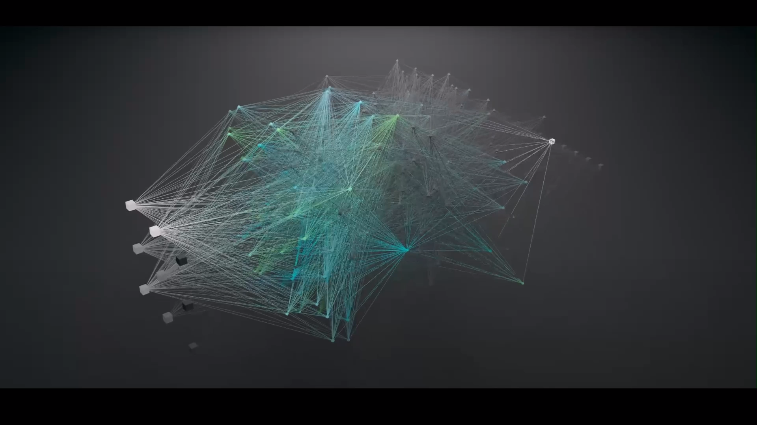
Neural Network Training
Devarsh Patel
Harsh Ranpura

Slide 2


Slide 3
Introduction to Neural Network Training
Training a neural network involves adjusting the weights of connections between neurons to minimize prediction error. This is done by iteratively updating the weights using optimization algorithms based on the gradients of a loss function.
Key Challenges in Training Neural Networks
Vanishing Gradients: Gradients become extremely small during backpropagation, leading to slow or halted learning.
Exploding Gradients: Gradients become excessively large, causing unstable updates and divergence.
Overfitting: The model memorizes the training data instead of generalizing it to unseen data.
Underfitting: The model is too simple to capture underlying patterns in the data.
https://youtu.be/rEDzUT3ymw4?si=X5zo6Qg9mZh9vHM4
Notes:
Definition – In simpler words, its just adjusting the connection(meaning weights) between neurons to reduce prediction errors Problems That Happen: Vanishing Gradients: Learning gets stuck because gradients (adjustments) become too small.
Exploding Gradients: Updates become too big and cause instability.
Overfitting: The model memorizes the training data but fails on new data.
Underfitting: The model is too simple to understand the data properly.

Slide 4
Neural networks are inspired by the structure and function of the human brain. They consist of layers of interconnected neurons, where each neuron performs a simple computation. The goal of training a neural network is to adjust the weights of these connections so that the network can accurately map inputs to outputs. This is achieved through a process called backpropagation, where the network learns by minimizing a loss function that measures the difference between the predicted and actual outputs. The optimization process involves calculating the gradient of the loss function with respect to each weight and updating the weights using an optimization algorithm like gradient descent. Over time, the network learns to make better predictions by iteratively adjusting its weights.

Slide 5
Techniques to Improve Training
Initialization Strategies:
Xavier Initialization: Scales weights to maintain variance across layers.
He Initialization: Optimized for ReLU activations.
Activation Functions:
ReLU: Efficient and mitigates vanishing gradients.
Leaky ReLU: Allows small gradients for negative inputs.
Batch Normalization: Normalizes intermediate outputs, stabilizing and accelerating training.
Optimizers:
SGD: Basic gradient descent method.
Adam: Combines momentum and adaptive learning rates.
RMSprop: Scales learning rates based on recent gradients.
Regularization Methods:
L1/L2 Regularization: Penalizes large weights.
Dropout: Randomly deactivates neurons to prevent overfitting.
Notes:
Solutions (Techniques to Help Training):
Better Starting Weights (Initialization):
Xavier: Good for balanced networks.
He: Good for networks using ReLU activation.
Activation Functions (Help Neurons Respond Better):
ReLU: Simple and avoids vanishing gradients.
Leaky ReLU: Similar, but allows small values for negatives.
Batch Normalization: Keeps the values flowing through the network stable, helping faster and more reliable learning.
Optimizers (Smart Ways to Adjust Weights):
SGD: Basic method.
Adam: More advanced, adapts speed for each weight.
RMSprop: Similar, scales based on recent progress.
Regularization (Avoid Overfitting):
L1/L2: Penalizes large weights.
Dropout: Randomly turns off parts of the network during training.

Slide 6
Key Figures in the field
Geoffrey Hinton: Often referred to as the "Godfather of Deep Learning," Hinton's work on backpropagation and dropout has been foundational in the field. His research has enabled the training of deep neural networks, which were previously thought to be untrainable.
Yoshua Bengio: Bengio has made significant contributions to understanding sequence modeling and unsupervised learning. His work on attention mechanisms and generative models has been instrumental in advancing natural language processing and other areas of AI.
Yann LeCun: LeCun is best known for developing convolutional neural networks (CNNs), which are widely used in image recognition tasks. His work on efficient training algorithms like stochastic gradient descent (SGD) has also been crucial in making deep learning practical.

Slide 7
Key Terms to Define
Backpropagation: This is the core algorithm used to train neural networks. It involves computing the gradient of the loss function with respect to each weight by applying the chain rule of calculus. The gradients are then used to update the weights in the direction that minimizes the loss.
Gradient Descent: This is an optimization algorithm used to minimize the loss function. It works by iteratively adjusting the weights in the direction of the negative gradient. Variants like stochastic gradient descent (SGD) and mini-batch gradient descent are commonly used in practice.
Regularization: Regularization techniques are used to prevent overfitting by adding a penalty for complexity to the loss function. L1 regularization adds a penalty proportional to the absolute value of the weights, while L2 regularization adds a penalty proportional to the square of the weights. Dropout is another regularization technique that randomly deactivates neurons during training.

Slide 8
Backpropagation, Step by Step/Gradient Descent/
https://youtu.be/Ilg3gGewQ5U?si=O7aJRLnu8rBxUM0X
https://youtu.be/IHZwWFHWa-w?si=gQG2WFNdn-0ZsQJ_

Slide 9


Slide 10
Business Application - Early Detection of Breast Cancer
The application of neural networks in healthcare, particularly for early detection of diseases like breast cancer, is a prime example of how AI can have a real-world impact. By analyzing large datasets of medical images and patient records, neural networks can identify patterns that are difficult for human doctors to detect. This not only improves the accuracy of diagnoses but also reduces the time and cost associated with traditional diagnostic methods. Moreover, the scalability of neural networks means that this technology can be deployed in underserved areas, improving access to quality healthcare globally.

Slide 11
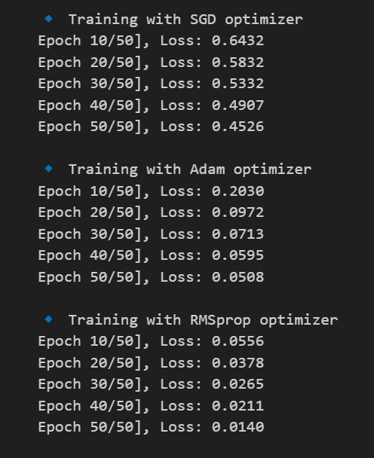
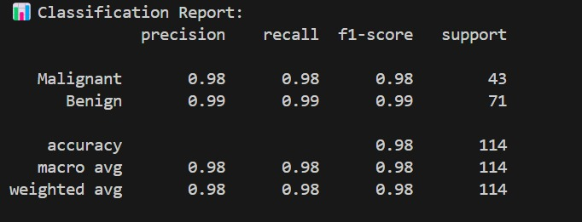
Business Application/GitHub repository
https://github.com/Harshranpura/Breast-Cancer-Analysis

Slide 12
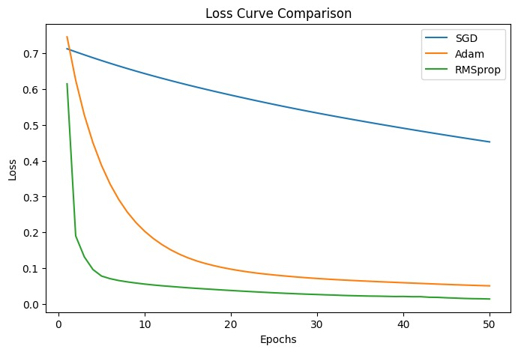
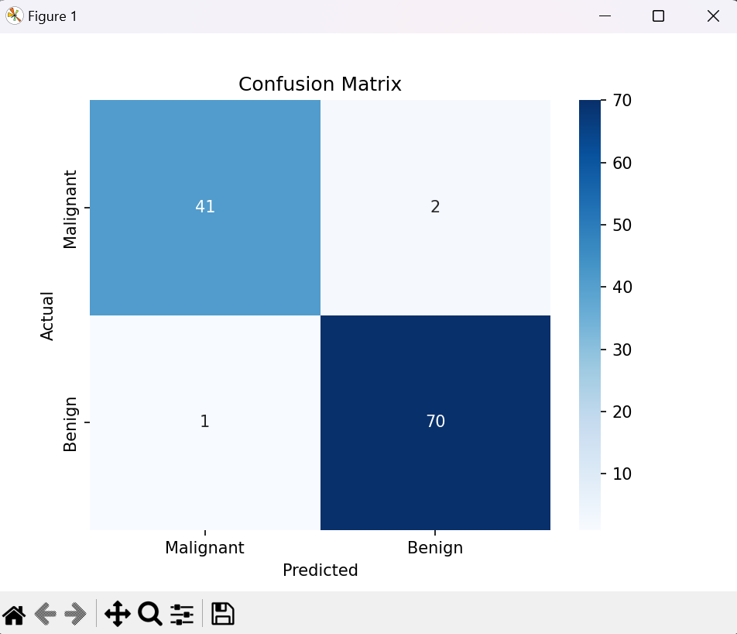

Slide 13
Business Use Case: Early Detection of Breast Cancer
1. Problem Statement
Breast cancer is one of the most common cancers worldwide, affecting millions of women each year. Early detection is critical for successful treatment and improved survival rates. However, traditional diagnostic methods (e.g., manual analysis of mammograms or biopsy results) have limitations
Time-Consuming: Doctors need to manually review medical data, which can delay diagnosis.
Human Error: Misdiagnosis can occur due to fatigue or oversight.
Costly: Manual diagnosis requires significant resources, including skilled professionals and expensive equipment.

Slide 14
Solution: Neural Networks for Automated Diagnosis
Neural networks can analyze medical data (e.g., tumor features, mammograms, or patient records) to predict whether a tumor is malignant (cancerous) or benign (non-cancerous). This automated approach offers several advantages:
Speed: Neural networks can process large datasets in seconds, providing instant predictions.
Accuracy: By learning from thousands of examples, neural networks can identify subtle patterns that humans might miss.
Scalability: The model can be deployed in hospitals and clinics worldwide, improving access to early diagnosis.

Slide 15
How It Works: Data Collection:
Collect data from patients, such as tumor features (e.g., size, shape, texture) or mammogram images.
label the data as malignant or benign based on biopsy results.
Model Training: Train a neural network on the labeled data to learn patterns associated with malignant and benign tumors.
Use techniques like cross-validation and hyperparameter tuning to optimize the model.
Deployment:
Integrate the trained model into a hospital’s workflow (e.g., as a web app or API).
Doctors can input patient data (e.g., tumor features) and receive instant predictions.
Monitoring and Improvement:
Continuously update the model with new data to improve its accuracy over time. Monitor performance metrics (e.g., accuracy, precision, recall) to ensure reliability.

Slide 16
Business Value:
Improved Patient Outcomes: Early detection increases the chances of successful treatment and survival.
Cost Savings: Automating diagnosis reduces the need for manual analysis, saving time and resources.
Scalability: The model can be deployed in multiple hospitals, improving access to quality healthcare.
Competitive Advantage: Hospitals using this technology can attract more patients by offering faster and more accurate diagnoses.
Real-World Impact
Reduced Mortality Rates: Early detection can significantly reduce breast cancer mortality rates.
Personalized Treatment: The model can help doctors tailor treatment plans based on the predicted severity of the tumor.
Global Reach: The technology can be deployed in underserved areas, improving access to early diagnosis.

Slide 17
WHY THIS TECHNLOGY HAS POTENTIAL:
High Accuracy: Neural networks can achieve accuracy levels comparable to or better than human experts.
Automation: Reduces the workload on doctors, allowing them to focus on treatment.
Scalability: Can be deployed in hospitals worldwide, improving access to early diagnosis.
Continuous Improvement: The model can be updated with new data, ensuring it remains accurate and reliable.
Real-World Applications: Beyond healthcare, neural networks are transforming industries like finance, retail, and manufacturing.
"Neural networks have the potential to revolutionize healthcare by enabling early detection of diseases like breast cancer. By automating diagnosis, we can save lives, reduce costs, and improve access to quality healthcare. This technology is not just a tool—it’s a game-changer for patients, doctors, and hospitals worldwide."

Slide 18
Group Activity: Neural Network Debugging Challenge
Your task is to debug and improve a flawed neural network by identifying and fixing issues that are hindering its performance. By doing this, you’ll gain hands-on experience with key techniques used to train neural networks effectively, such as:
Proper weight initialization.
Batch normalization.
Adaptive optimizers.
These techniques are critical for building models that converge faster, generalize better, and perform well in real-world applications like automated defect detection in manufacturing.

Slide 19
What You’ll do
Download the Starter Code:
Access the provided PyTorch script (flawed code) from the shared GitHub repository or Google Colab link.
Identify Issues:
Look for problems like poor initialization, missing batch normalization, or a suboptimal optimizer.
Implement Fixes:
Modify the code to include proper initialization, batch normalization, and an adaptive optimizer.
Train the Model:
Run the training process for both the original and improved code.
Observe the differences in training/validation accuracy and loss.

Slide 20
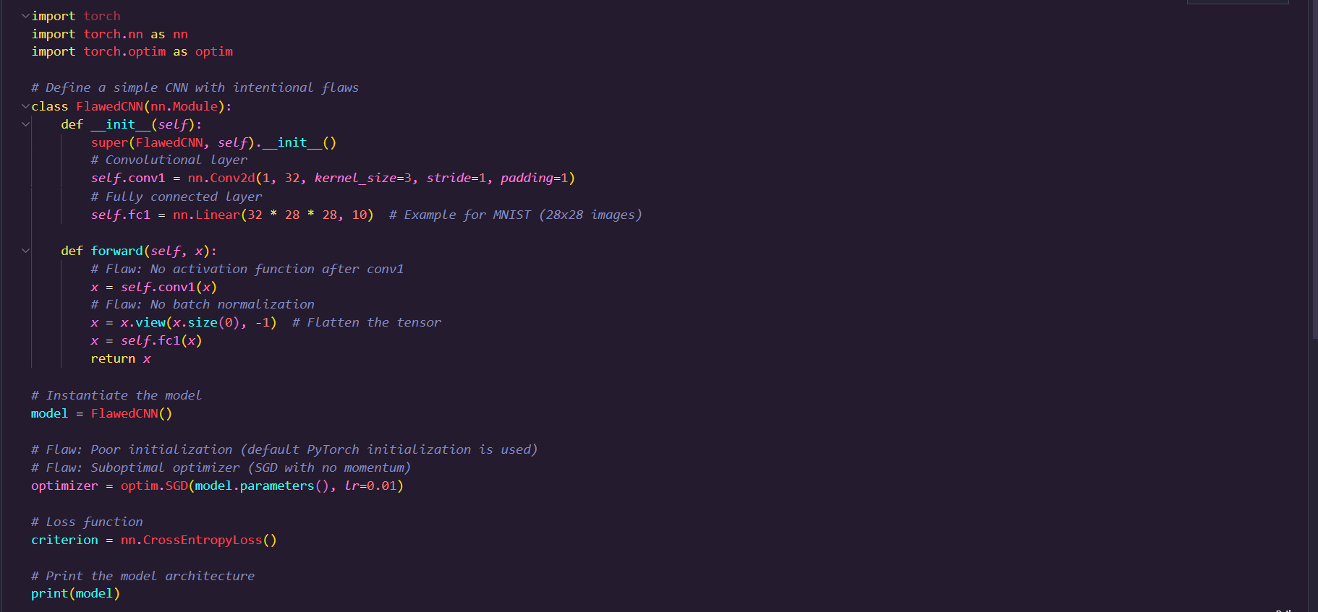
Starter Code: Flawed Neural Network

Slide 21
Key improvements to fix code
Proper Initialization:
Applied He initialization (nn.init.kaiming_normal_) to the weights of convolutional and fully connected layers.
Batch Normalization:
Added nn.BatchNorm2d after the convolutional layer to stabilize training.
Activation Function:
Added torch.relu after the convolutional layer to introduce non-linearity.
Optimizer:
Replaced SGD with Adam, which adapts learning rates for faster and more stable convergence.

Slide 22
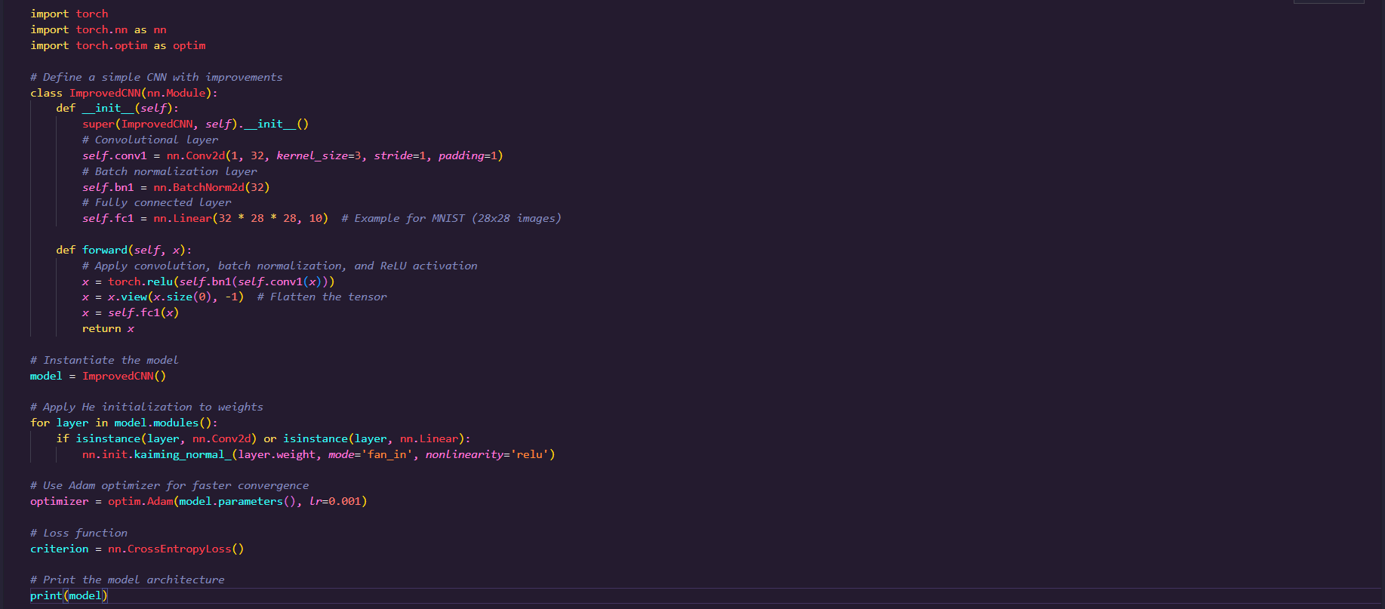
Corrected version

Slide 23
Thank you

